Slide 1
Session – 12
Agile Software Development
Introduction to Agile Development
Procedures and methods of Agile Development project

Slide 2
Recap for session 11
Agile Development
An Agile Process
Agile Model - Pros and Cons
The Manifesto for Agile Software Development
Agility Principles – I
Agility Principles – II
Agile Project Management
Agile Testing Methods
When to use the Agile Model?

Slide 3
Agenda for session 12
Agile Design
Agile Software Development
Value 1: Individuals and Interactions over Processes and Tools
Value 2: Working Software over Comprehensive Documentation
Value 3: Customer Collaboration over Contract Negotiation (1 of 2)
Value 4: Responding to Change over Following a Plan
Agile Principles (12)
Key components of Agile project management
What are the 6 steps in the Agile methodology?

Slide 4
Agile Design
Design plays a vital role in any software development process. The agile team also focuses on "what to do about design" because of the following four factors:
Many crucial factors focus on loyal designs during the planning process. Design forces towards waterfall culture throughout product implementation.
Designers also interact with a cross team for a limited time.
Designers don't always have an easy way to report feedback to the engineering team.
The presentation and logic layers are not still transparent. They are not separated clearly in the code base, making style changes difficult.

Slide 5
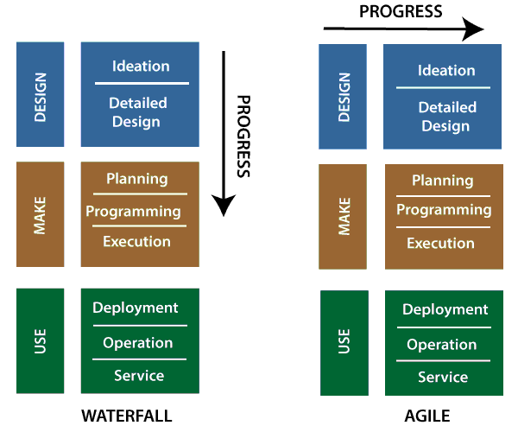
Agile Design (cont..)
The product design process and customer interview
The agile is divided into several methodologies and processes. These methodologies and processes keep the iterative and free-flowing nature of the technique at their core. The agile design and development methodology used especially in engineering development, and this process called Scrum.

Slide 6
Agile Design (cont..)
Customer interviews can be an informative part of the project design phase. We will have several of those "light bulb" movements during interviews. It encourages the people who are interviewing with other members of the team (engineering, marketing, design, etc.)
There are several resources that are available on which we conduct an interview- the logistics, methods, and techniques.

Slide 7
Agile Software Development
Agile development is more than a framework such as Kanban, Scrum, and Extreme Programming of Feature-Driven Development (FDD).
It is more than practice, such as planning, test-driven development, planning sessions, stand-ups, and sprints.
Agile software development contains the set of frameworks, so it is called as an umbrella term. These frameworks are based on the values and principles expressed in Agile manifesto.
The things that separate agile from other approaches to software development are the focus on the people doing the work and how they work together. The agile software development communities focus on collaboration and the self-organizing team.
Mostly the team and organization start work doing on agile software development, and then they focus on practices that help with collaboration and organizing the work.

Slide 8
How to Be an Awesome Agile Developer
The agile team developers focus on sustainable development?
not heroics. Software sustainability is good estimation, effective branching strategies for managing code. This code is executed by automated testing to protect the quality, and continuous deployment to get fast feedback from users. Agile development is a continuous deployment to get quick feedback from users.
The "iron triangle" is a project management system in which all the developers should know about the project scope, schedule, and quality development.

Slide 9
a. Software Development Method
Agile Software Development (Cont…)
A software development methodology or system development methodology in software engineering is a framework that is used to structure, plan, and control the process of developing an information system.

Slide 10
b. Software Engineering / Software Development
Agile Software Development (Cont…)
Software Engineering (WIKI) (SE) is the application of a systematic, disciplined, quantifiable approach to the design, development, operation, and maintenance of software, and the study of these approaches; that is, the application of engineering to software.
Software Development, a much used and more generic term, does not subsume the engineering paradigm.
  The field's future looks bright according to Money Magazine and Salary.com, which rated "software engineer" as the best job in the United States in 2006.
  In 2012, software engineering was again ranked as the best job in the United States, this time by CareerCast.com.

Slide 11
c. Information System
Agile Software Development (Cont…)
An information system (IS) - is any combination of information technology (IT) and people's activities that support operations, management and decision making.
In a very broad sense, the term information system is frequently used to refer to the interaction between people, processes, data and technology.
In this sense, the term is used to refer
  not only to the information and communication technology (ICT) that an organization uses,
  but also to the way in which people interact with this technology in support of business processes. (Wiki)

Slide 12
d. Iterative and Incremental Development
Agile Software Development (Cont…)
Iterative and Incremental development is at the heart of a cyclic software development process developed in response to the weaknesses of the waterfall model.
It starts with an initial planning and ends with deployment with the cyclic interactions in between.
Iterative and incremental development are essential parts of the Rational Unified Process, Extreme Programming and generally the various agile software development frameworks.
It follows a similar process to the “plan-do-check-act” cycle of business process improvement.

Slide 13
e. Time-Boxed Approach
Agile Software Development (Cont…)
In time management, a time box allots a fixed period of time for an activity.
Timeboxing plans activity by allocating time boxes.

Slide 14
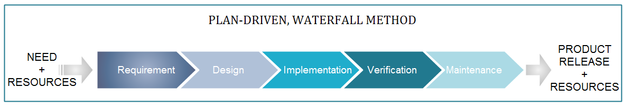
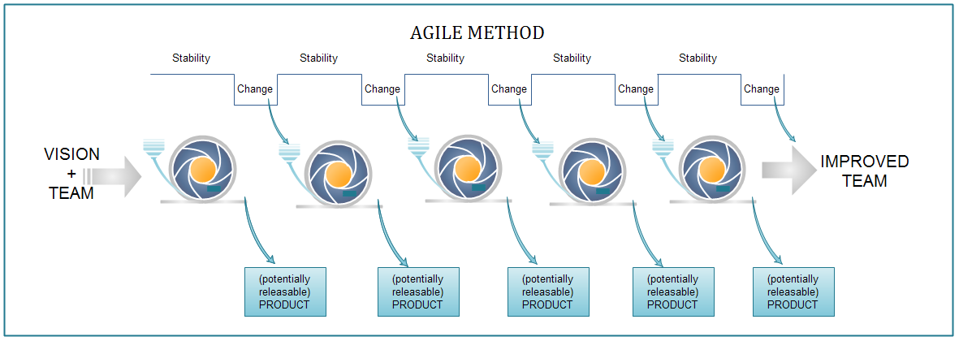
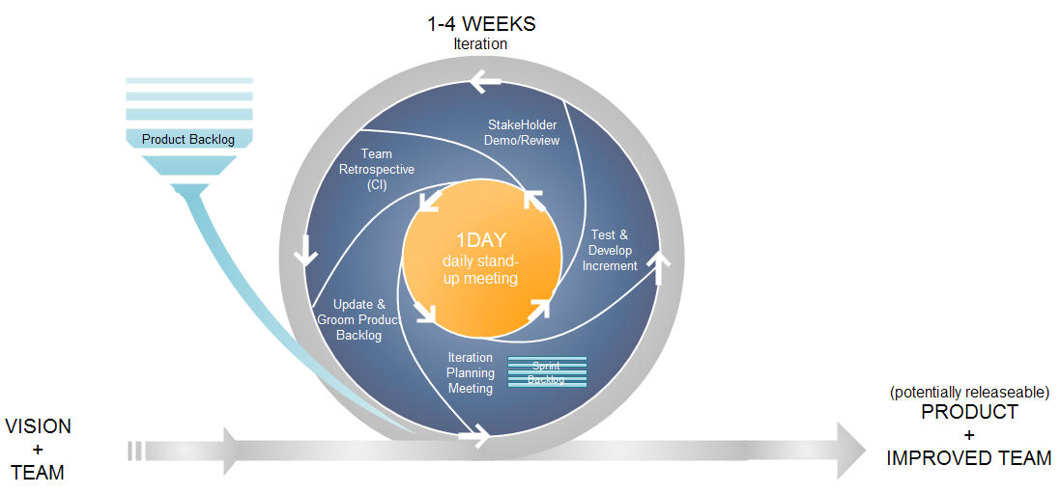
Copyright © 2010 AgileInnovation

Slide 15
Value 1: Individuals and Interactions over Processes and Tools
Strong players: a must, but can fail if don’t work together.
Strong player: not necessarily an ‘ace;’ work well with others!
  Communication and interacting is more important than raw talent.
‘Right’ tools are vital to smooth functioning of a team.
Start small. Find a free tool and use until you can demo you’ve outgrown it. Don’t assume bigger is better. Start with white board; flat files before going to a huge database.
Building a team more important than building environment.
  Some managers build the environment and expect the team to fall together.
  Doesn’t work.
  Let the team build the environment on the basis of need.

Slide 16
Value 2: Working Software over Comprehensive Documentation
Code – not ideal medium for communicating rationale and system structure.
  Team needs to produce human readable documents describing system and design decision rationale.
Too much documentation is worse than too little.
  Take time; more to keep in sync with code; Not kept in sync? it is a lie and misleading.
Short rationale and structure document.
  Keep this in sync; Only highest level structure in the system kept.

Slide 17
Value 2: Working Software over Comprehensive Documentation
How to train newbees if short & sweet?
  Work closely with them.
  Transfer knowledge by sitting with them; make part of team via close training and interaction
Two essentials for transferring info to new team members:
  Code is the only unambiguous source of information.
  Team holds every-changing roadmap of systems in their heads; cannot put on paper.
  Best way to transfer info- interact with them.
Fatal flaw: Pursue documentation instead of software:
Rule: Produce no document unless need is immediate and significant.

Slide 18
Value 3: Customer Collaboration over Contract Negotiation (1 of 2)
Not possible to describe software requirements up front and leave someone else to develop it within cost and on time.
Customers cannot just cite needs and go away
Successful projects require customer feedback on a regular and frequent basis – and not dependent upon a contract or SOW.

Slide 19
Value 4: Responding to Change over Following a Plan
Our plans and the ability to respond to changes is critical!
Course of a project cannot be predicted far into the future.
  Too many variables; not many good ways at estimating cost.
Tempting to create a PERT or Ghant chart for whole project.
  This does Not give novice managers control.
  Can track individual tasks, compare to actual dates w/planned dates and react to discrepancies.
  But the structure of the chart will degrade
  As developers gain knowledge of the system and as customer gains knowledge about their needs, some tasks will become unnecessary; others will be discovered and will be added to ‘the list.’
  In short, the plan will undergo changes in shape, not just dates.

Slide 20
Value 4: Responding to Change over Following a Plan
Better planning strategy – make detailed plans for the next few weeks, very rough plans for the next few months, and extremely crude plans beyond that.
Need to know what we will be working on the next few weeks; roughly for the next few months; a vague idea what system will do after a year.
Only invest in a detailed plan for immediate tasks; once plan is made, difficult to change due to momentum and commitment.
  But rest of plan remains flexible. The lower resolution parts of the plan can be changed with relative ease.

Slide 21
Agile Principles (12)
The following principles are those that
differentiate agile processes from others.

Slide 22
Principle 1: Our Highest Priority is to Satisfy the Customer through Early and Continuous Delivery of Valuable Software
Number of practices have significant impact upon quality of final system:
1. Strong correlation between quality and early delivery of a partially functioning system.
  The less functional the initial delivery, the higher the quality of the final delivery.
2. Another strong correlation exists between final quality and frequently deliveries of increasing functionality.
  The more frequent the deliveries, the higher the final quality.
Agile processes deliver early and often.
  Rudimentary system first followed by systems of increasing functionality every few weeks.
  Customers my use these systems in production, or
  May choose to review existing functionality and report on changes to be made.
  Regardless, they must provide meaningful feedback.

Slide 23
Principle 2: Welcome Changing Requirements, even late in Development. Agile Processes harness change for the Customer’s Competitive Advantage.
This is a statement of attitude.
Participants in an agile process are not afraid of change.
  Requirement changes are good;
  Mean team has learned more about what it will take to satisfy the market.
Agile teams work to keep the software structure flexible, so requirement change impact is minimal.
Moreso, the principles of object oriented design help us to maintain this kind of flexibility.

Slide 24
Principle 3: Deliver Working Software Frequently
(From a couple of weeks to a couple of months with a preference to the shorter time scale.
We deliver working software.
  Deliver early and often.
  Be not content with delivering bundles of documents, or plans.
  Don’t count those as true deliverables.
The goal of delivering software that satisfies the customer’s needs.

Slide 25
Principle 4: Business People and Developers Must Work Together Daily throughout the Project.
For agile projects, there must be significant and frequent interaction between the
  customers,
  developers, and
  stakeholders.
An agile project must be continuously guided.

Slide 26
Principle 5: Build Projects around Motivated Individuals. (Give them the environment and support they need, and trust them to get the job done.)
An agile project has people the most important factor of success.
  All other factors, process, environment, management, etc., are considered to be second order effects, and are subject to change if they are having an adverse effect upon the people.
Example: if the office environment is an obstacle to the team, change the office environment.
If certain process steps are obstacles to the team, change the process steps.

Slide 27
Principle 6: The Most Efficient and Effective Method of Conveying Information to and within a Development Team is face-to-face Communications.
In agile projects, developers talk to each other.
  The primary mode of communication is conversation.
  Documents may be created, but there is no attempt to capture all project information in writing.
An agile project team does not demand written specs, written plans, or written designs.
  They may create them if they perceive an immediate and significant need, but they are not the default.
  The default is conversation.

Slide 28
Principle 7: Working Software is the Primary Measure of Progress
Agile projects measure their progress by measuring the amount of working software.
  Progress not measusred by phase we are in, or
  by the volume of produced documentation or
  by the amount of code they have created.
Agile teams are 30% done when 30% of the necessary functionality is working.

Slide 29
Principle 8: Agile Processes promote sustainable developmt The sponsors, developers, and users should be able to maintain a constant pace indefinitely.
An agile project is not run like a 50 yard dash; it is run like a marathon.
  The team does not take off at full speed and try to maintain that speed for the duration.
  Rather they run at a fast, but sustainable, pace.
Running too fast leads to burnout, shortcuts, and debacle.
Agile teams pace themselves.
  They don’t allow themselves to get too tired.
  They don’t borrow tomorrow’s energy to get a bit more done today.
  They work at a rate that allows them to maintain the highest quality standards for the duration of the project.

Slide 30
Principle 9: Continuous Attention to Technical Excellence and Good Design enhances Agility.
High quality is the key to high speed.
  The way to go fast is to keep the software as clean and robust as possible.
  Thus, all agile team-members are committed to producing only the highest quality code they can.
  They do not make messes and then tell themselves they’ll clean it up when they have more time.
  Do it right the first time!

Slide 31
Principle 10: Simplicity – the art of maximizing the amount of work not done – is essential.
Agile teams take the simplest path that is consistent with their goals.
  They don’t anticipate tomorrow’s problems and try to defend against them today.
  Rather they do the simplest and highest quality work today, confident that it will be easy to change if and when tomorrows problems arise.

Slide 32
Principle 11: The Best Architectures, Requirements, and Designs emerge from Self-Organizing Teams
An agile team is a self organizing team.
  Responsibilities are not handed to individual team members from the outside.
  Responsibilities are communicated to the team as a whole, and the team determines the best way to fulfill them.
Agile team members work together on all project aspects.
  Each is allowed input into the whole.
  No single team member is responsible for the architecture, or the requirements, or the tests, etc.
  The team shares those responsibilities and each team member has influence over them.

Slide 33
Principle 12: At regular Intervals, the Team reflects on how to become more effective, then tunes and adjusts its behavior accordingly.
An agile team continually adjusts its organization, rules, conventions, relationships, etc.
An agile team knows that its environment is continuously changing, and knows that they must change with that environment to remain agile.

Slide 34
Key components of Agile project management
User stories
Put simply, a user story is a high-level definition of a work request. It contains just enough information so the team can produce a reasonable estimate of the effort required to accomplish the request. This short, simple description is written from the user’s perspective and focuses on outlining what your client wants (their goals) and why.
Sprints
Sprints are a short iteration, usually between one to three weeks to complete, where teams work on tasks determined in the sprint planning meeting. As you move forward, the idea is to continuously repeat these sprints until your product is feature ready. Once the sprint is over, you review the product see what is and isn’t working, make adjustments, and begin another sprint to improve the product or service.
Stand-up meetings
Daily stand-up meetings (under 10 minutes), also known as “daily Scrum meetings,” are a great way to ensure everyone is on track and informed. These daily interactions are known as “stand up” because the participants are required to stay standing, helping to keep the meetings short and to the point.
.

Slide 35
Agile board
An Agile board helps your team track the progress of your project. This can be a whiteboard with sticky notes, a simple Kanban board,
Backlog
As project requests are added through your intake system, they become outstanding stories in the backlog. During Agile planning sessions, your team will estimate story points to each task. During sprint planning, stories in the backlog are moved into the sprint to be completed during the iteration. Managing your backlog is a vital role for project managers in an Agile environment
Different Agile methodologies may require specific team roles to adhere to the framework
Scrum Master. The Scrum Master ensures that each sprint stays on track and helps to remove or resolve any issues or challenges that may come up. They are the team’s advocate.
Product owner. The role of the product owner is to define the goals of each sprint, manage and prioritize the team backlog, and be the voice of the customer or internal stakeholder.
Team members. The people on this team are the ones who execute the work in each sprint. These teams, usually of three to seven people with different specialties and strengths..
Stakeholders. This is an informational role only. The stakeholders should be kept up-to-date on the product and sprint goals, have the opportunity to review and approve work during a sprint, and provide feedback during the sprint retrospective.

Slide 36
What are the 6 steps in the Agile methodology?
The goal of Agile is to produce shorter development cycles and more frequent product releases than traditional waterfall project management. This shorter time frame enables project teams to react to changes in the client’s needs more effectively.
Mostly used Agile frameworks—Scrum and Kanban follow the same basic process :
1.Project Planning
Like with any project, before beginning your team should understand the end goal, the value to the organization or client, and how it will be achieved.
so the project scope shouldn’t be seen as unchangeable.
2. Product roadmap creation
A roadmap is a breakdown of the features that will make up the final product. This is a crucial component of the planning stage of Agile, because your team will build these individual features during each sprint.At this point, you will also develop a product backlog,
3. Release planning
In traditional waterfall project management, there is one implementation date that comes after an entire project has been developed. When using Agile, however, your project uses shorter development cycles (called sprints) with features released at the end of each cycle.
Before kicking off the project, you’ll make a high-level plan for feature releases and at the beginning of each sprint, you’ll revisit and reassess the release plan for that feature.

Slide 37
4. Sprint planning
Before each sprint begins, the stakeholders need to hold a sprint planning meeting to determine what will be accomplished by each person during that sprint, how it will be achieved, and assess the task load. It’s important to share the load evenly among team members so they can accomplish their assigned tasks during the sprint.
5. Daily stand-ups
To help your team accomplish their tasks during each sprint and assess whether any changes need to be made, hold short daily stand-up meetings. During these meetings, each team member will briefly talk about what they accomplished the day before and what they will be working on that day.(Meeting Duration mostly :15 Min)
6. Sprint review and retrospective
After the end of each sprint, your team will hold two meetings: first, you will hold a sprint review with the project stakeholders to show them the finished product. This is an important part of keeping open communication with stakeholders. An in-person or video conference meeting allows both groups to build a relationship and discuss product issues that arise.
Second, you will have a sprint retrospective meeting with your stakeholders to discuss what went well during the sprint, what could have been better, whether the task load was too heavy or too light for each member, and what was accomplished during the sprint.

Slide 38
Conclusions
The professional goal of every software engineer, and every development team, is to deliver the highest possible value to our employers and customers.
  And yet, our projects fail, or fail to deliver value, at a dismaying rate.
Though well intentioned, the upward spiral of process inflation is culpable for at least some of this failure.
The principles and values of agile software development were formed as a way
  to help teams break the cycle of process inflation, and
  to focus on simple techniques for reaching their goals.
At the time of this writing there were many agile processes to choose from. These include
  SCRUM,
  Crystal,
  Feature Driven Development (FDD),
  Adaptive Software Development (ADP), and most significantly,
  Extreme Programming (XP).
  Others…

Slide 39
Questions
Define Agility? Explain Agile process.
Explain Classification of methods in agile development.
List out Agile principles.
Illustrate the agile manifesto.
explain agile project management with help of Safe Home application

